Slide 1
Preventing outbreaks: West Nile Virus in Chicago, IL
Blaine Murphy
7/28/2021

Slide 2
The problem
The first positive West Nile Virus (WNV) case in Chicago in 2002
20% of humans exposed to the virus will experience symptoms
1 / 150 infected will develop serious and sometimes fatal illness
Humans are infected primarily through the bites of virus-carrying mosquitos
Chicago Department of Public Health (CDPH) sought to mitigate risk by installing a system traps
70+ traps placed around the city each summer
Traps are sampled once a week or more, and tested for WNV
Pesticide spraying after positive tests
To spray proactively instead of reactively, can we employ machine learning to predict where WNV will occur based on weather data?
Yes, with recall/sensitivity of 85%

Slide 3
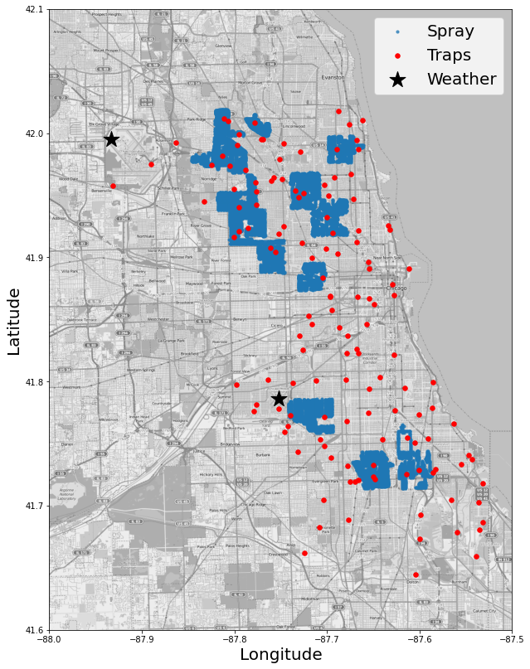
The Data
Traps data (Red)
73-116 traps that are collected (mostly) weekly
Location, number of mosquitos collected, species, and result of WNV test
Weather data (Black)
Data collected daily at stations located at airports ORD & MDW
Includes daily temperatures, precipitation, dew point, air pressure, wind speed and more
Spraying data (Blue)
Records of date, time and location of pesticide spraying

Slide 4
Traps Data Wrangling
Trap Data from 2007 to 2013
Date and location of trap collection
Number of mosquitos and species
WNV result
Target is ‘WnvPresent’
0 = negative, 1 = positive
Need to aggregate records split due to mosquito species and number of specimens
10,506 length data set becomes 4,616 records for training and testing
Year | Unique Date/Traps | # of Date/Traps >1 record
2007 | 1,459 | 1,006
2009 | 1,006 | 648
2011 | 988 | 574
2013 | 1,163 | 709

Slide 5
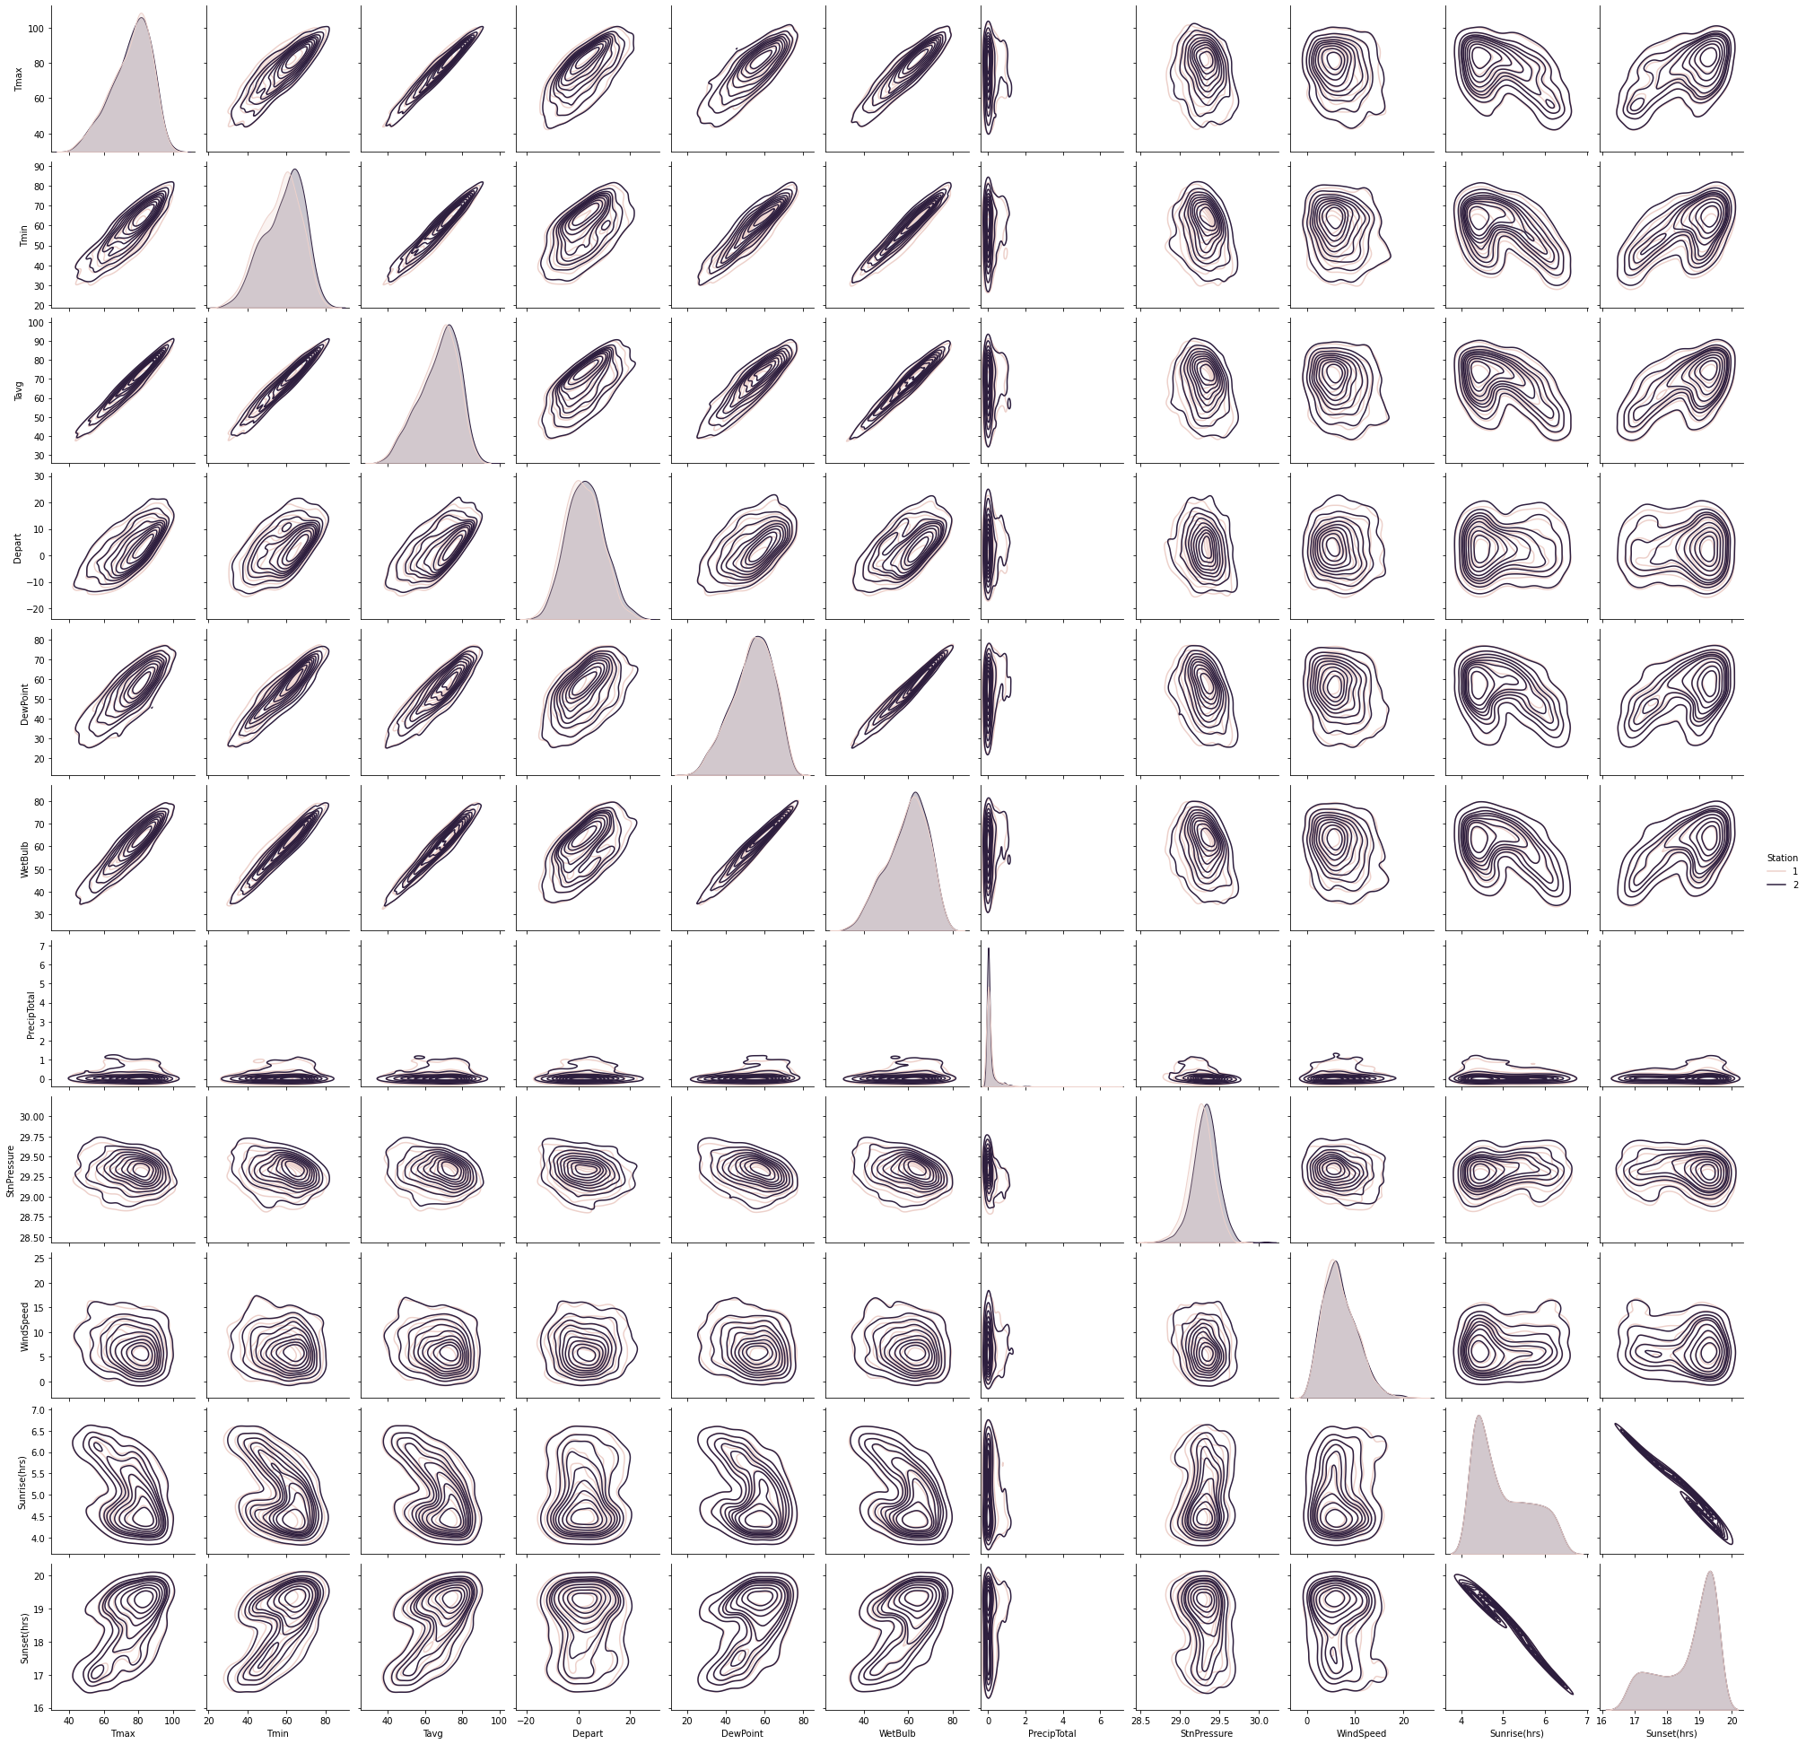
Weather Data Wrangling
Data includes daily measurements from 2 stations
Temperature max, min, average, & departure from norm
Precipitation
Dew point and air pressure
Wind speed and direction
Sunrise and sunset time
Filled in null values for a small number of values from the other station
Temperature Departure wasn’t reported from one station, filled using calculate norm from other station
Already see weather features are highly correlated and will need to be dropped to prevent overfitting
Weather data is joined to traps data on date, and which station is closest to that trap

Slide 6
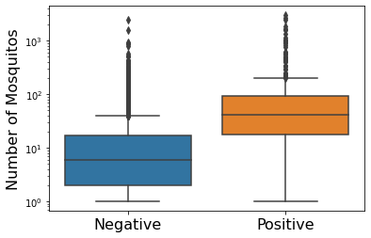
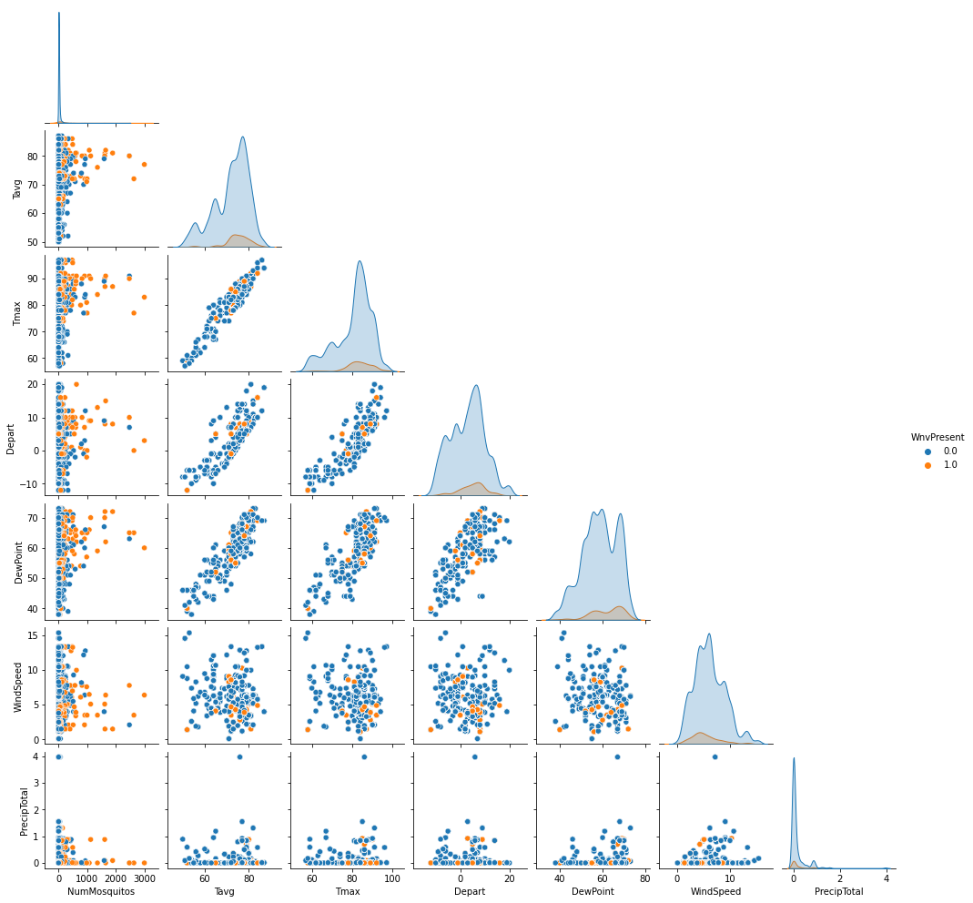
Exploratory analysis
Negative
Positive
The probability of a positive case greatly increases in samples which have a large number of mosquitos
But none of the weather features correlate strongly to the number of mosquitos

Slide 7
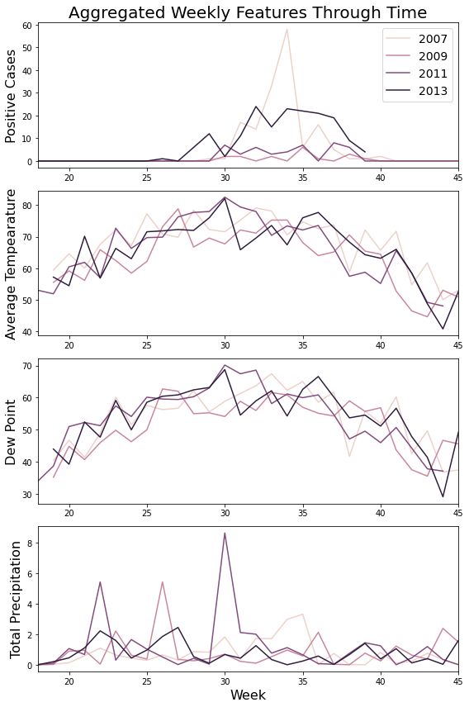
Exploratory analysis
Plotting features through time suggests mosquitos are more prevalent during warm and high dew point days.
From personal experience, I encounter more mosquitos on warm days after a significant rainfall
Reminder, traps are a sample of up to 7 days in the past
Solution based on intuition and sample rate is to create weather features from the near past
Lagged features up to 10 days in the past
Aggregated some features from the near past

Slide 8
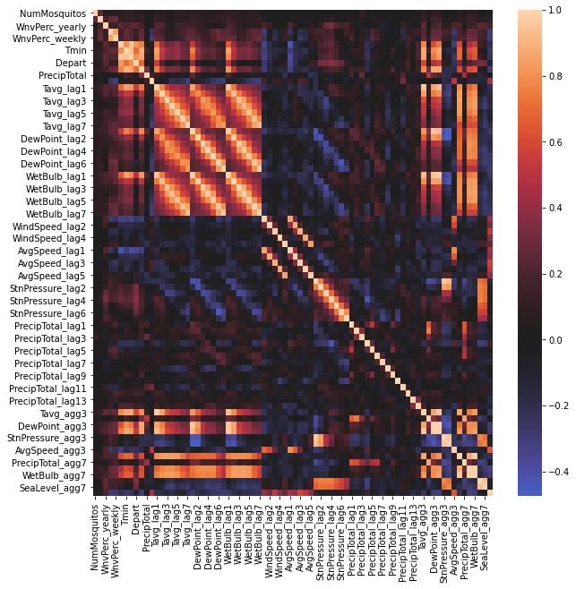
Feature creation
Creating lagged features and aggregated features has resulted in 111 features
Still nothing appears to correlate strongly with the number of mosquitos or WNV test result (first two rows from top)
Many features are strongly correlated to other features and will need to be dropped
Many features dropped because they are not available for prediction

Slide 9
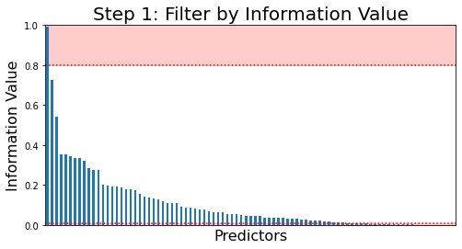
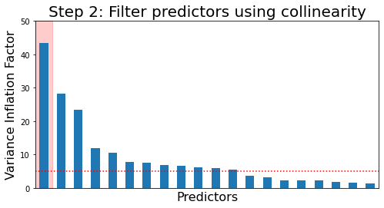
Feature Processing
Data split into 80% training set and 20% testing set (stratified)
Reduce number of predictors to avoid overfitting (start with 89)
Step 1:
Calculate the Information Value for each predictor to the target
Drop predictors with IV less than 0.01
Drop predictors with IV greater than 0.8
Reduced predictors to 64
Step 2:
Calculate the Variance Inflation Factor for each feature
If the largest VIF >5 then drop that predictor and iterate
Reduced predictors to 13
Iteration: 45

Slide 10
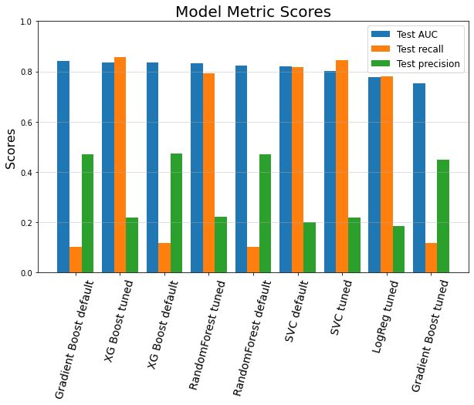
Model Selection
Fit the data on several different models using default and tuning hyper-parameters through searching and cross-validation
Logistic Regression
Random Forest Classifier
Decision Tree Gradient Boost Classifier
XG Boost Classifier
Support Vector Classifier
Selected XG Boost based on highest ROC AUC score with strong recall.
Prioritize recall for this application to minimize the number of false negatives.

Slide 11
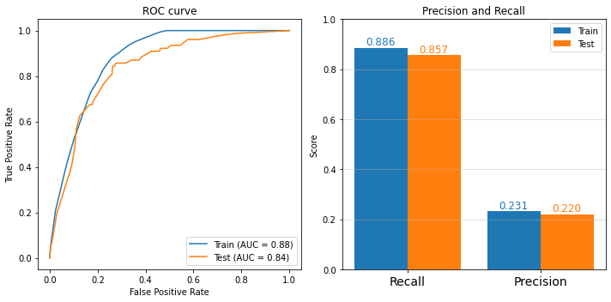
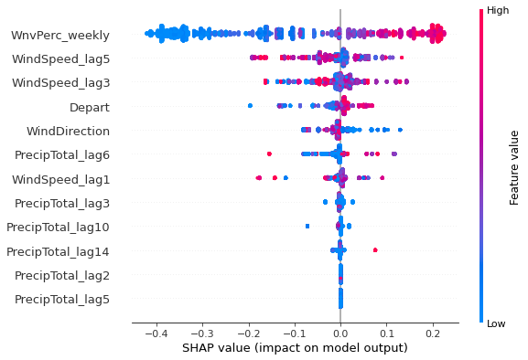
Modelling Performance
Plot below shows the feature importance to the output of the model.
Historical weekly positive case percentage is most impactful on the model
Temperature, lagged wind speed and precipitation also influence model output
Good performance on hold-out test set with an ROC AUC=84% and recall=85%
The model generalizes well to the test set as there is not significant difference between the training and testing scores

Slide 12
Recommendations
The XG Boost model is ready for deployment, a text file provides details on the model
Recommend that the model is run on a daily basis with up to date weather data from the two stations.
The model performance indicates there will be a significant number of false positives, and costs are always a limitation
The model can predict probability of a positive case at each location.
Recommend that WNV case probabilities are calculated and spraying is focused on areas of the city with the highest modeled probability for WNV
CDPH can plan council resources to be used for spraying using predictions from the model

Slide 13
Further work
Examination of spatial weather sampling
Model accuracy could decreases as a function of trap distance from the weather station
If so significantly, recommend adding a weather station during the summer months for more dense weather sampling
Standardize mosquito trap sampling.
Traps are sometimes sampled more than once per week.
Possible to up-sample these cases and see if result is improved.
Also add in ‘missing’ trap collections assuming negative WNV test to further help train the model
Include spraying data
Potentially the spraying of mosquitos could cause the what would normally be a positive case based on weather conditions to result in a negative case
Check to see if that is happening and include spraying data if it is.

